Slide 1
Ch 4
Basic shell programming

Slide 2
CONTENT
01
03
Shell Scripts and Functions
String Operators
02
04
Shell Variables
Command Substitution

Slide 3
CONTENT
05
Advanced Examples: pushd and popd

Slide 4
Shell scripts and functions
A script (a file that contains shell commands) is a shell program. Even the previously discussed .bash_profile and other environment files are shell scripts.
To run shell scripts:
source scriptname
You can run a script by typing its name only if the directory where the script is located is in your command search path, or . (the current directory)
If these aren’t in your path, you must type ./scriptname, which is the same as typing the absolute pathname of the script.
Use the chmod command to add executing permissions by typing : chmod +x scriptname
using source causes the commands in the script to be run as if they were part of your login session

Slide 5
Shell scripts and functions
A function is sort of a script-within-a-script; you use it to define some shell code by name and store it in the shell’s memory, to be invoked and run later.
When you invoke a function, it is already in the shell’s memory; therefore a function runs faster.
They are ideal for organizing long shell scripts into modular “chunks” of code that are easier to develop and maintain.
function functname{
shell commands}
or:
functname ()
{
shell commands}

Slide 6
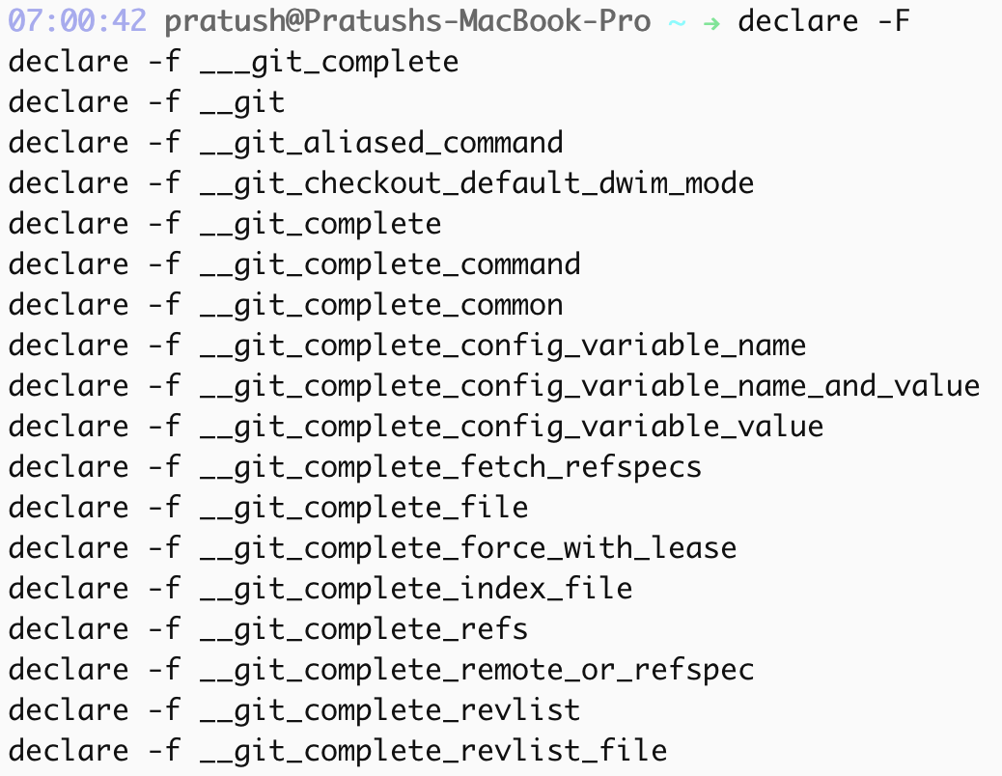
Shell scripts and functions
You can also delete a function definition with the command unset -f functname.
You can find out what functions are defined in your login session by typing declare -f.
If you just want to see the names of the functions, you can use declare -F.
The order of precedence :
1. Aliases
2. Keywords such as function and several others, like if and for.
3. Functions
4. Built-ins like cd and type
5. Scripts and executable programs, for which the shell searches in the directories listed in the PATH environment variable.
To change the order of precedence by using the built-ins command, builtin, and enable.

Slide 7
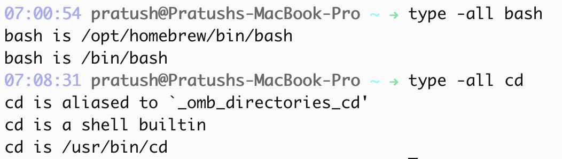
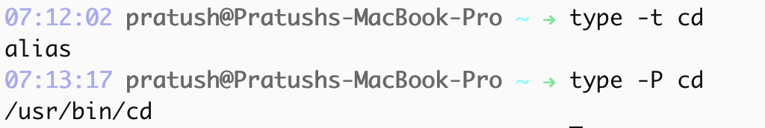
Shell scripts and functions
The type built-in command by itself will print how bash would interpret the command, based on the search locations listed above.
Use type -a or type -all to get all the definations for a command.
It is also possible to restrict the search to commands that are executable files or shell scripts by using the -p option.
The -P option forces type to look for executable files or shellscripts even if the result of -t would not return file.
The -f option, suppresses shell function lookup, i.e. ,only keywords, files and aliases will be returned.

Slide 8
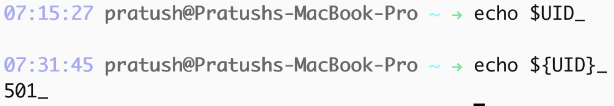
Shell variables
Certain variables, called environment variables, are conventionally named in all capital letters, and their values are made known (with the export statement) to subprocesses.
Positional parameters : One of the most important special, built-in variables are called positional parameters. $0, whose value is the name of the script. * and @ are special variables containing all of the positional parameters.
“$*” is a single string and is separated by the first character in the value of the environment variable IFS.
“$@” is equal to “$1” “$2” ...“$N”, where N is the number of positional parameters which are separated by spaces.
The variable # holds the number of positional parameters.
A local statement inside a function definition makes the variables involved all become local to that function. Generally all variables are global unless specified otherwise.
It is safe to omit the curly brackets ({}) if the variable name is followed by a character that isn’t a letter, digit, or underscore.

Slide 9
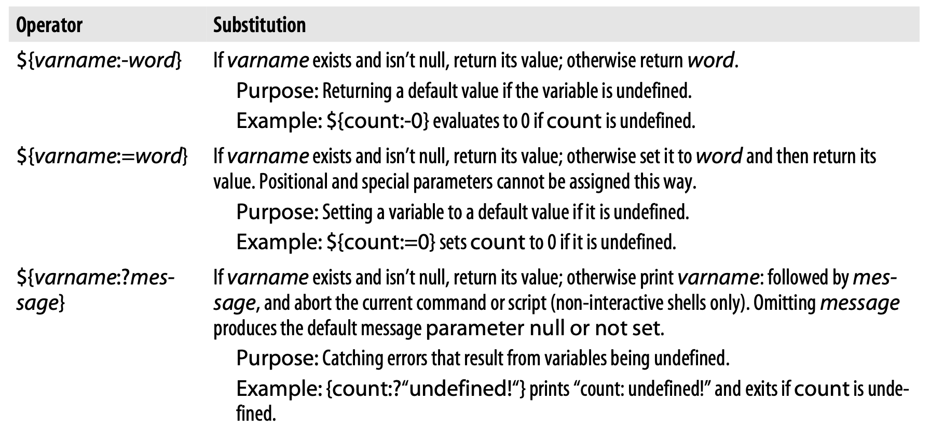
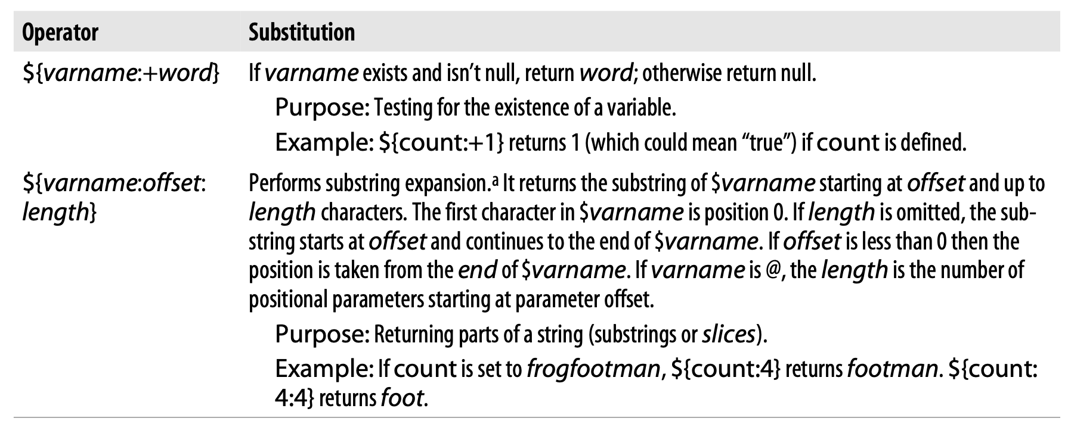
String operators

Slide 10
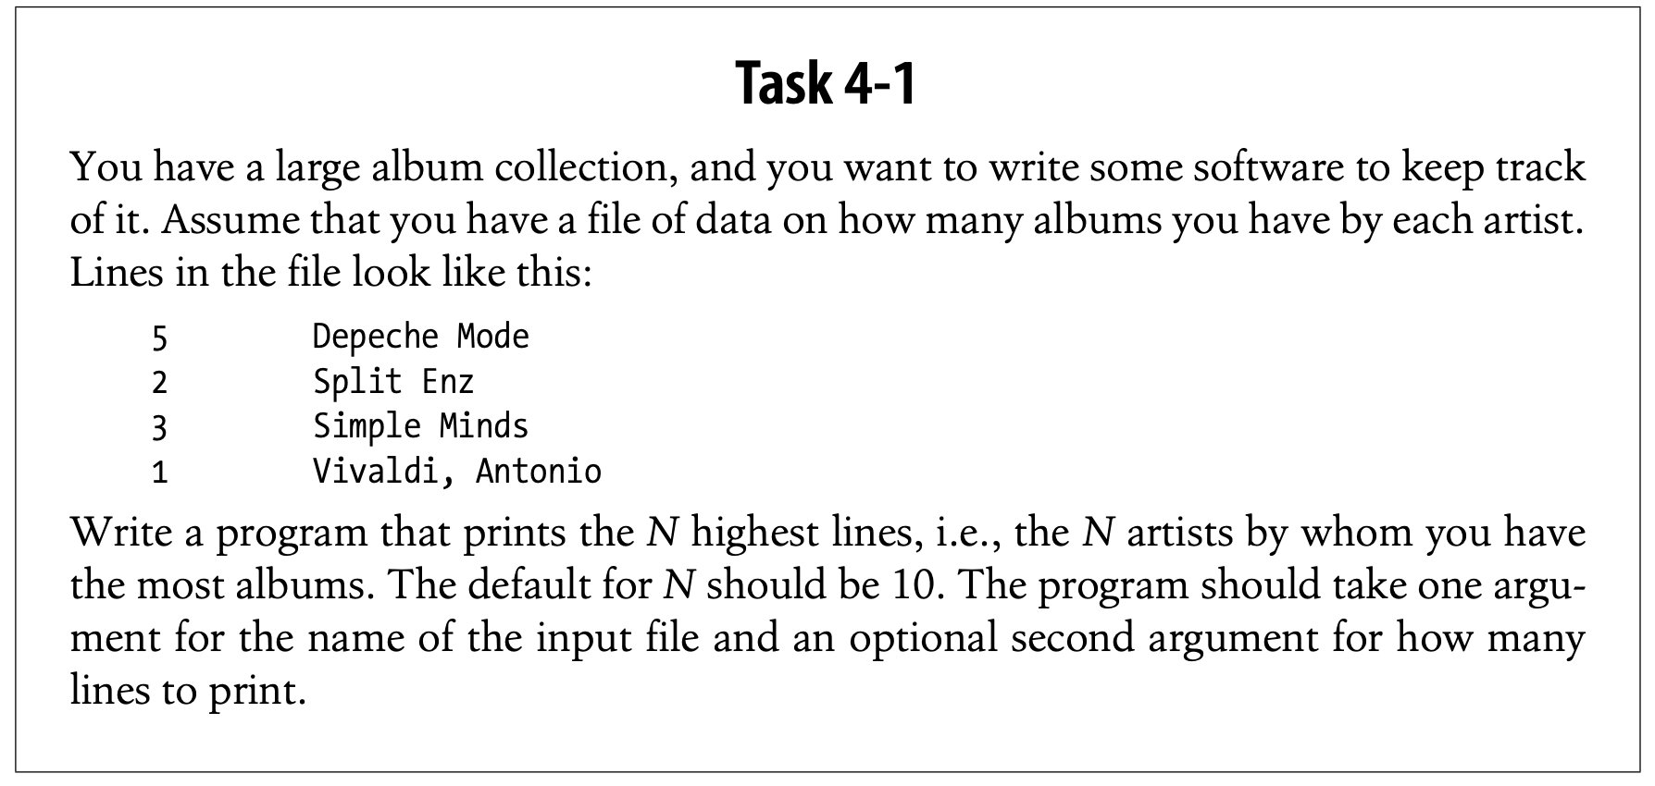
String operators
sort -nr command expects the number to be at the start of the line.
sort -nr $1 | head -${2:-10}
Sort the file whose name is given as the first argument ($1).
-n option tells sort to interpret the first word on each line as a number. -r tells it to reverse the order of comparison (i.e. descending order)
The output of sort is piped into the head utility, which, when given the argument -N, prints the first N lines of its input on the standard output. In case the $2 argument is not specified then it prints 10 lines of its input to the standard output.

Slide 11
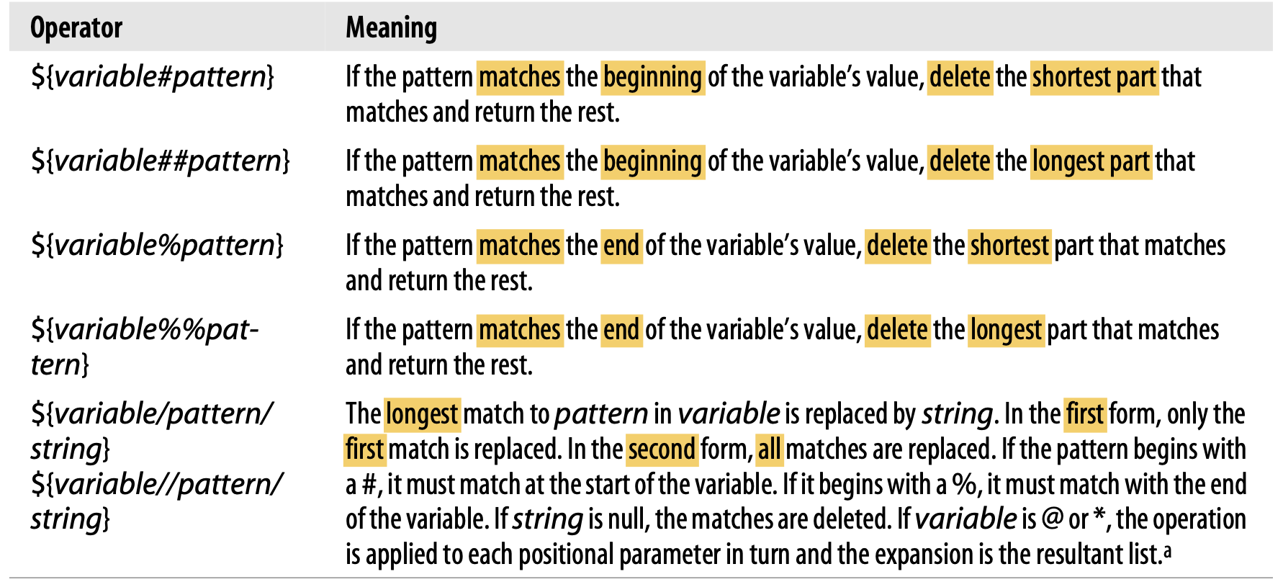

String operators
Patterns and pattern matching:
# matches the front; % matches the rear.
outfile=${filename%.pcx}.jpg strips the filename from the extension and attaches .jpg to its end.

Slide 12
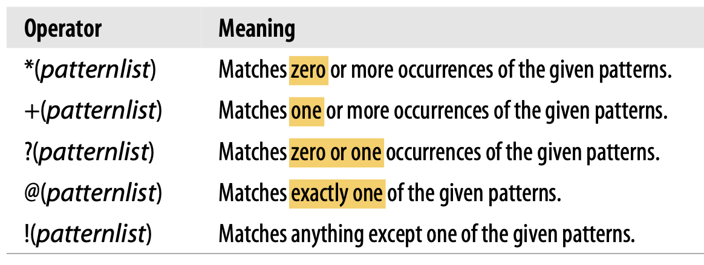
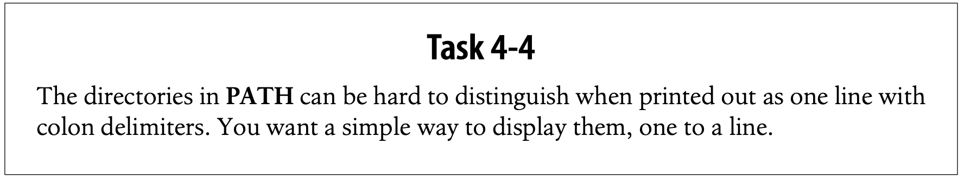
String operators
echo -e ${PATH//:/'\n'}
Each occurrence of the colon is replaced by \n.The -e option allows echo to interpret \n as a LINEFEED.
${#varname} is the length operator.
Extended Pattern Matching:
Turn on the shopt option extglob

Slide 13
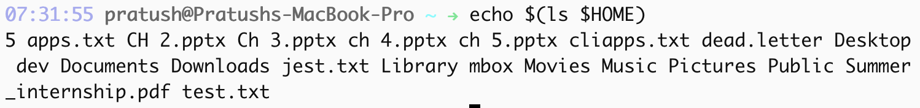
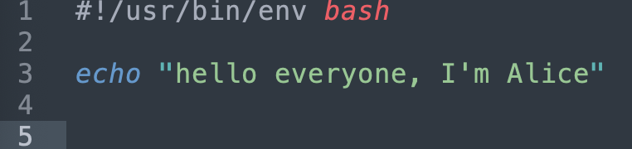
Command substitution
Command substitution allows you to use the standard output of a command as if it were the value of a variable.
The syntax of command substitution is: $(UNIX command)
$(pwd) is the current directory. $(ls $HOME) is the names of all files in your home directory. $(ls $(pwd)) is the names of all files in the current directory.
vi $(grep -l 'command substitution' ch*) ; phrase“commandsubstitution”, is matched assuming that your chapter files all begin with ch.
cut is a data filter: it extracts columns from tabular data. If you supply the numbers of columns you want to extract from the input, cut will print only those columns on the standard output.
we could use cut to extract the fourth (year) column in task 4-2 if the year was inthe 4th column: cut -f4 -d\| albums
The-d argument is used to specify the character used as field delimiter (TAB is the default).The verticalbar must be backslash-escaped so that the shell doesn’t try to interpret it as a pipe.

Slide 14

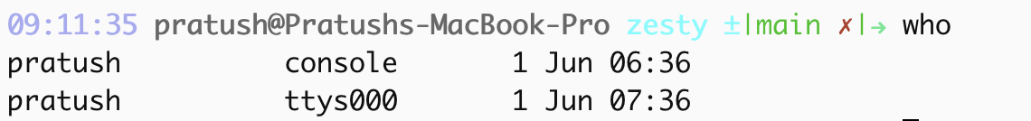
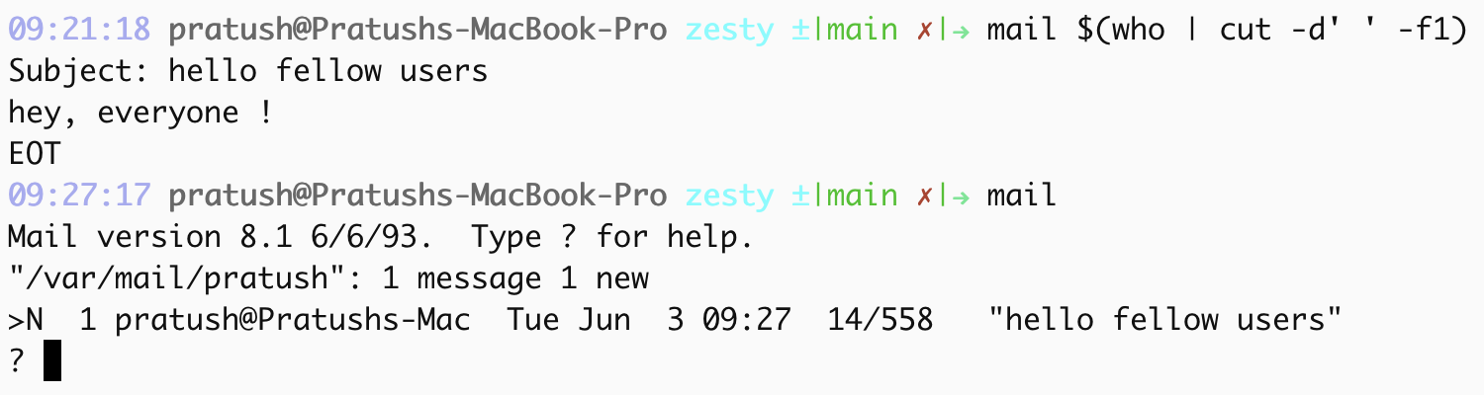
Command substitution
The command who tells you who is logged in.
Since we need the first field (i.e. the user names), we can get away with using a space as the field separator in the cut command.
who | cut -d' ' -f1 ; prints active terminal user names.
mail $(who | cut -d' ' -f1) ; sends a mail to every active user.

Slide 15
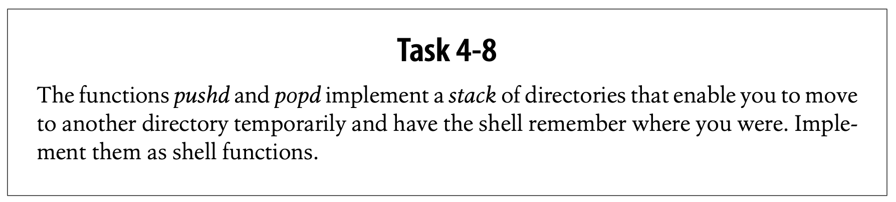
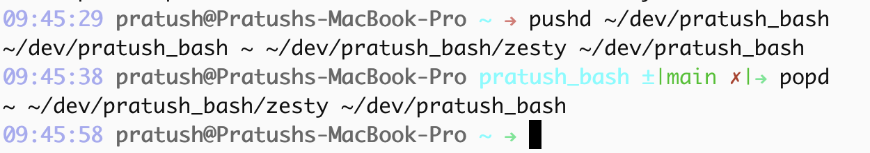
Advanced Examples: pushd and popd
The functions pushd and popd implement a stack of directories that enable you to move to an other directory temporarily and have the shell remember where you were.
pushd pushes the current directory onto the stack, then cds to dir and pushes it onto the stack.
popd removes the top directory off the stack, revealing a new top. Then it cds to the new top directory.

Slide 16
THANK YOU
More Professional PowerPoint, Keynote, Google Slides Templates

